Slide 1
Deep Learning Model Experiment And NRI Dataset Exploration
For rPPG
Week-3
Rafsan Jany (02513052)
Korean Convergence Medical Science

Slide 2
Experimental DL Models And NRI Datasets
Result Analysis For RR (UBFC)
CCUHR NRI Dataset Form (TU)
Enhanced PhysNet
Landmark Guided MTTS_CAN
Transformer Enhanced MTTS_CAN
Tried to Implement MTTS_CAN from the paper
Graph Neural Net Concept Design
Exploring Dataset
Converted The .bag to .mp4 using pyrealsense2

Slide 3
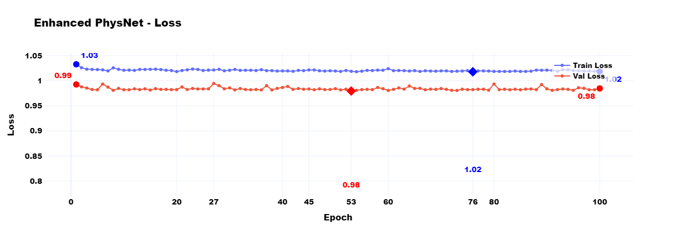
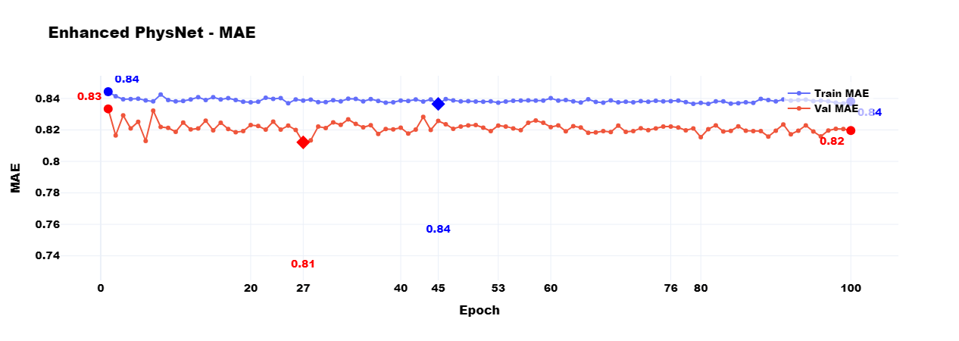
Enhanced PhysNet

Slide 4
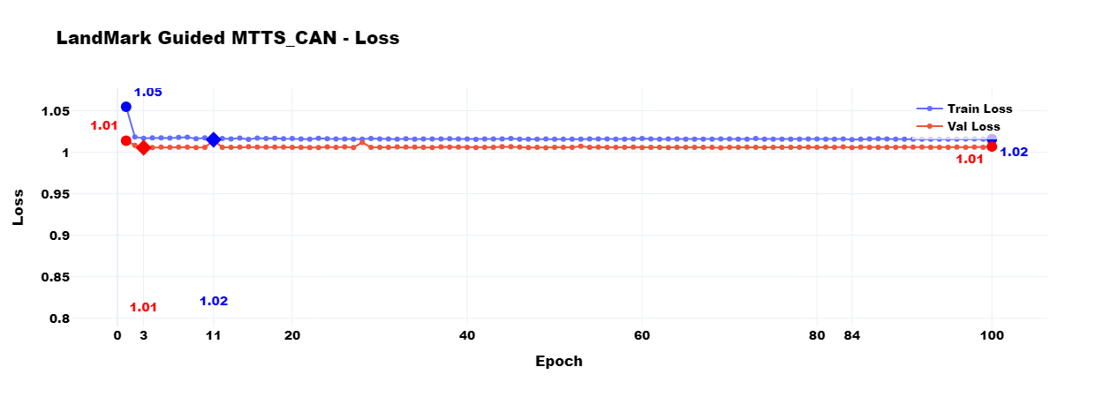
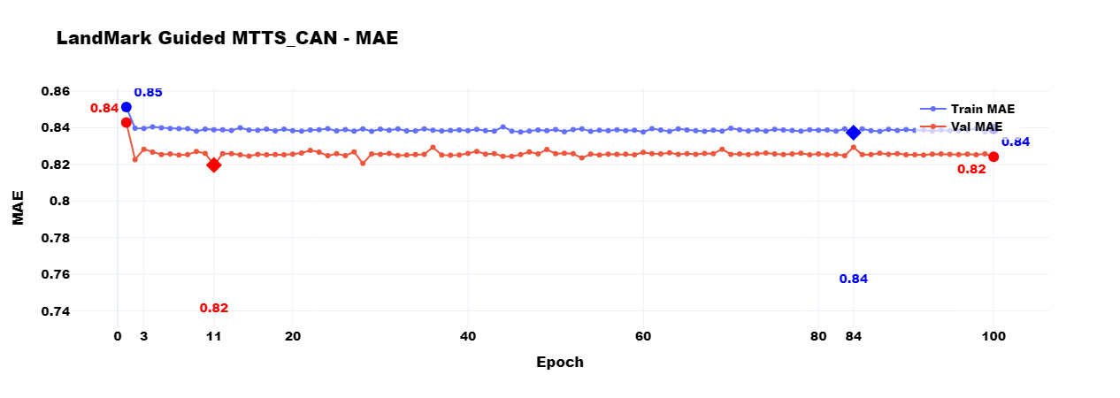
Landmark Guided MTTS_CAN

Slide 5
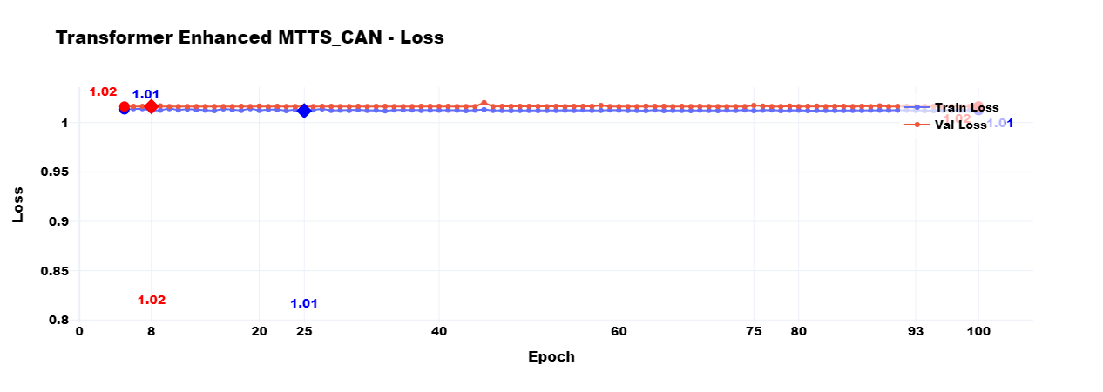
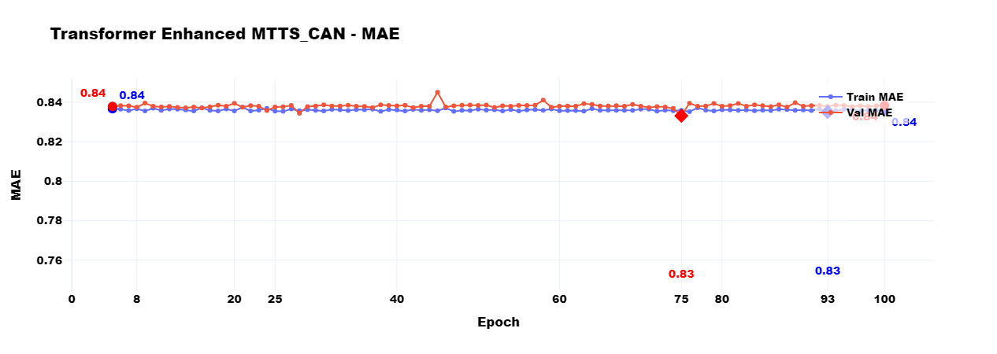
Transformer Enhanced MTTS_CAN

Slide 6
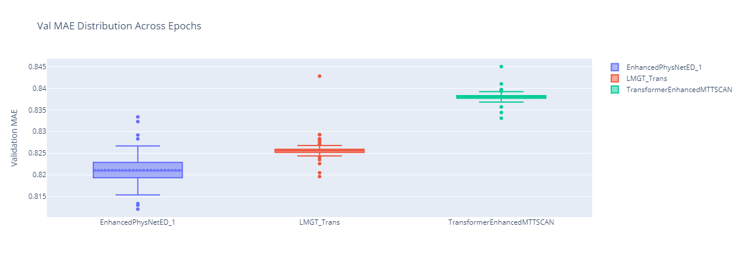
BOX PLOT

Slide 7
CCUHR NRI Dataset Form (TU)
CCUHR
|*.csv (12 files with directory and ground truth)
|motion
| |Slightmove 20s
| | |*.bag (10 subjects)
| | |gt.txt (single hr for each subject)
| |Slightmove 10s
| | |*.bag (10 subjects) | | |gt.txt (single hr for each subject)
| |Emotion 20s
| | |*.bag (11 subjects)
| | |gt.txt (single hr for each subject)
| |Emotion 10s
| | |*.bag (10 subjects)
| | |gt.txt (single hr for each subject)
|no_motion

Slide 8
CCUHR NRI Dataset Form (TU)
CCUHR
|
|.......
|no_motion
|Stop 30s
| | *.bag (15 subjects)
| | gt.txt (single hr for each subject)
|Stop 20s
| | *.bag (15 subjects)
| | gt.txt (single hr for each subject)
|Stop 10s
| | *.bag (14 subjects)
| | gt.txt (single hr for each subject)
|Stationary 10s
| | *.bag (11 subjects)
| | gt.txt (single hr for each subject)
………
CCUHR
|
|.......
|no_motion
|.........
|original
| | *.bag (11 subjects)
| | GT
| | | *.lvm (ground truth)
|No light 30s
| | *.bag (5 subjects)
| | gt.txt (single hr for each subject)
|No light 20s
| | *.bag (5 subjects)
| | gt.txt (single hr for each subject)
…………..

Slide 9
CCUHR NRI Dataset Form (TU)
CCUHR
|
|.......
|no_motion
|.........
|No light 10s
| | *.bag (5 subjects)
| | gt.txt (single hr for each subject)
|Most Dark 30s
| | *.bag (6 subjects)
| | gt.txt (single hr for each subject)
|Most Dark 20s
| | *.bag (6 subjects)
| | gt.txt (single hr for each subject)
………..
CCUHR
|
|.......
|no_motion
|.........
|Most Dark 10s
| | *.bag (6 subjects)
| | gt.txt (single hr for each subject)
|Lamp_30s
| | *.bag (5 subjects)
| | gt.txt (single hr for each subject)
|Lamp_20s
| | *.bag (5 subjects)
| | gt.txt (single hr for each subject)
……..

Slide 10
CCUHR NRI Dataset Form (TU)
CCUHR
|
|.......
|no_motion
|.........
|Lamp_10s
| | *.bag (5 subjects)
| | gt.txt (single hr for each subject)
|Dark 20s
| | *.bag (5 subjects)
| | gt.txt (single hr for each subject)
|Dark 10s
| | *.bag (7 subjects)
| | gt.txt (single hr for each subject)

Slide 11
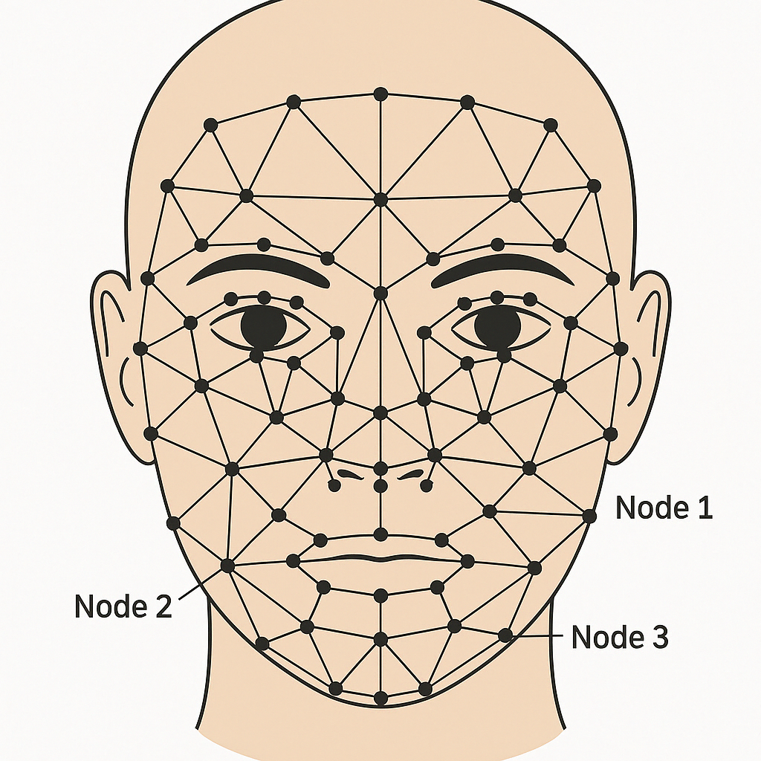
Concept Design For Graph Neural Net Method
Spatio-Temporal Graph Neural Network (ST-GNN)
Landmark-aware GNN (Variant of ST-GNN)

Slide 12
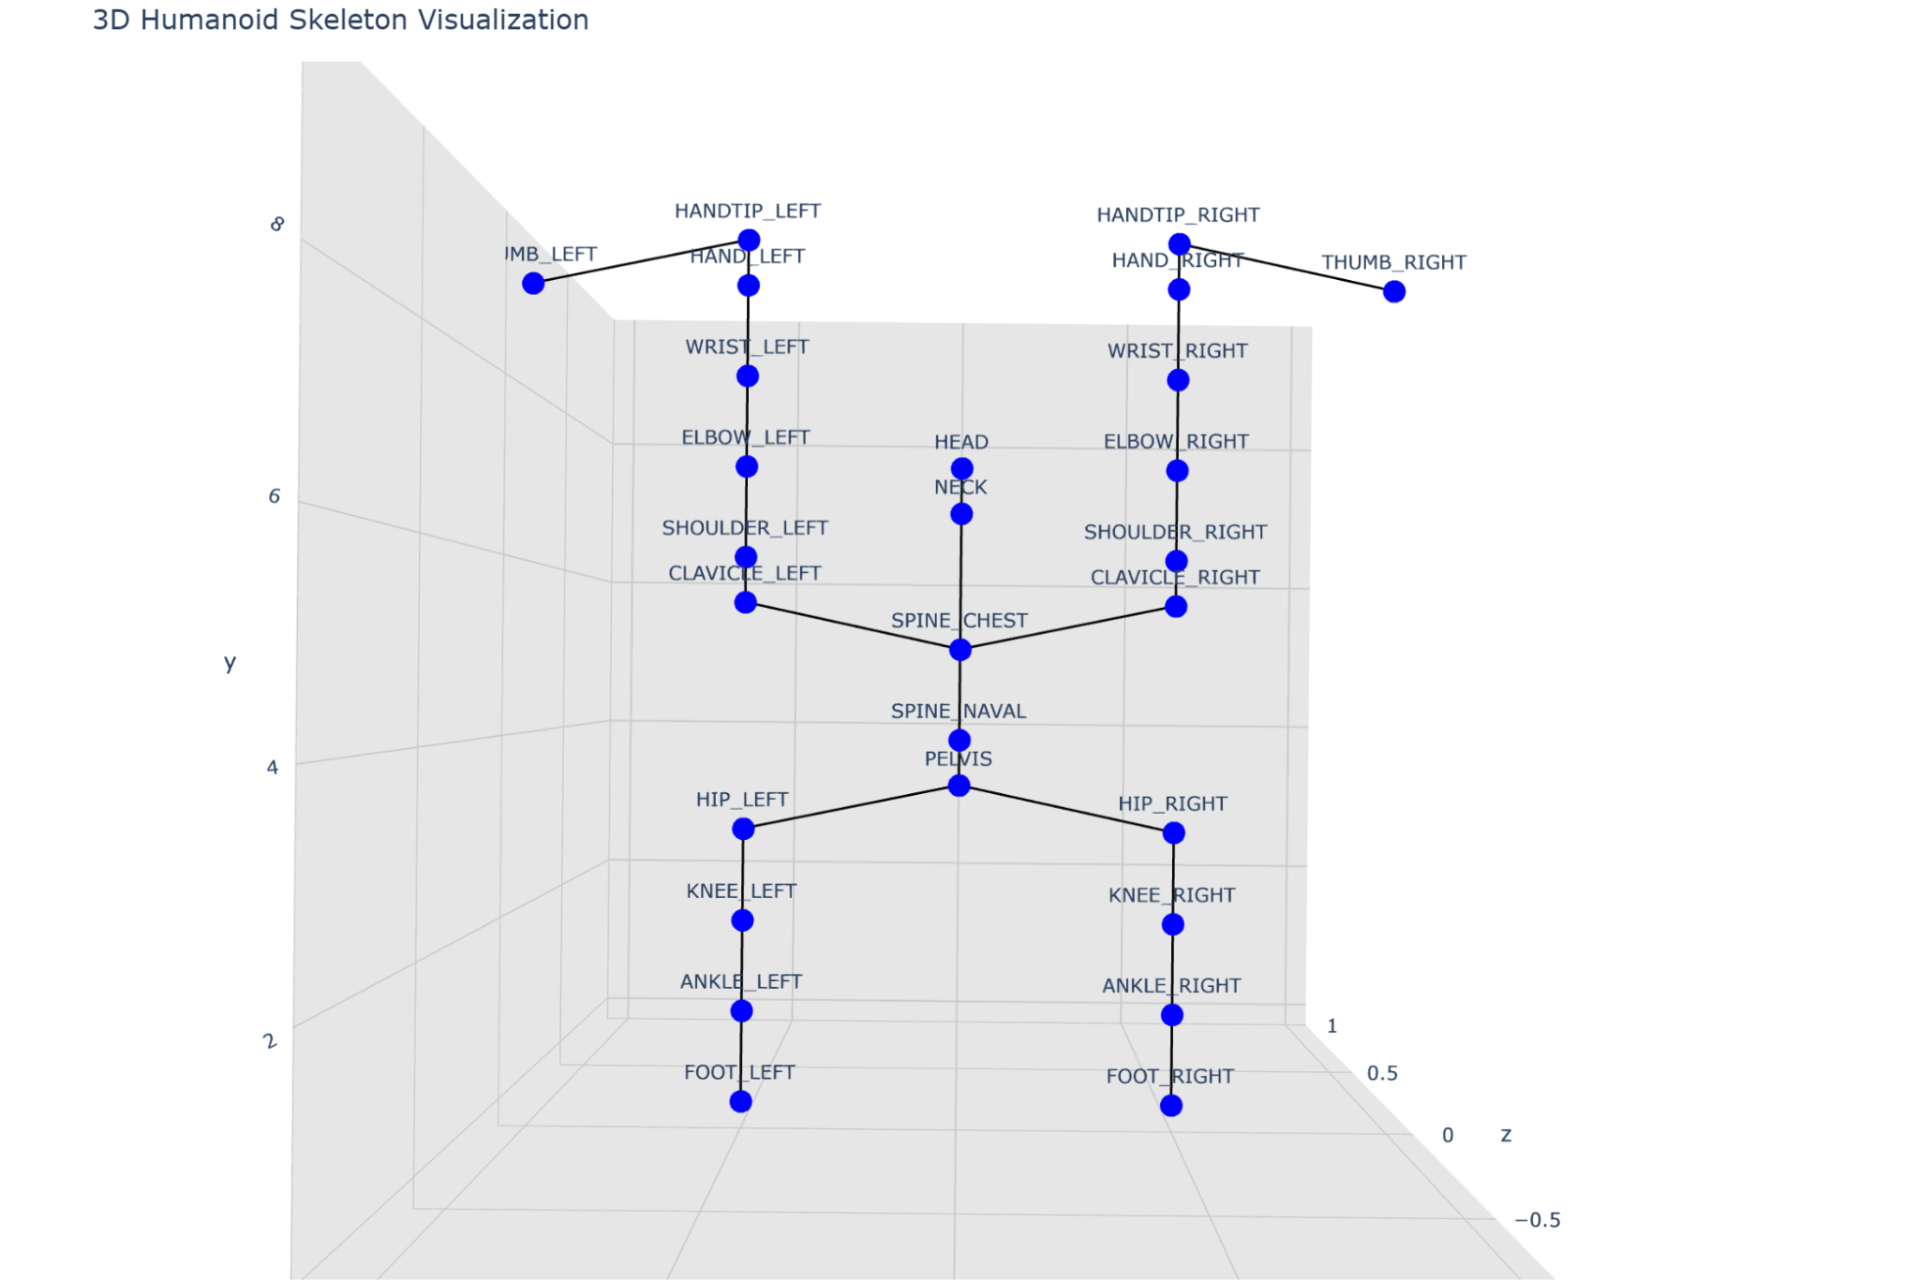
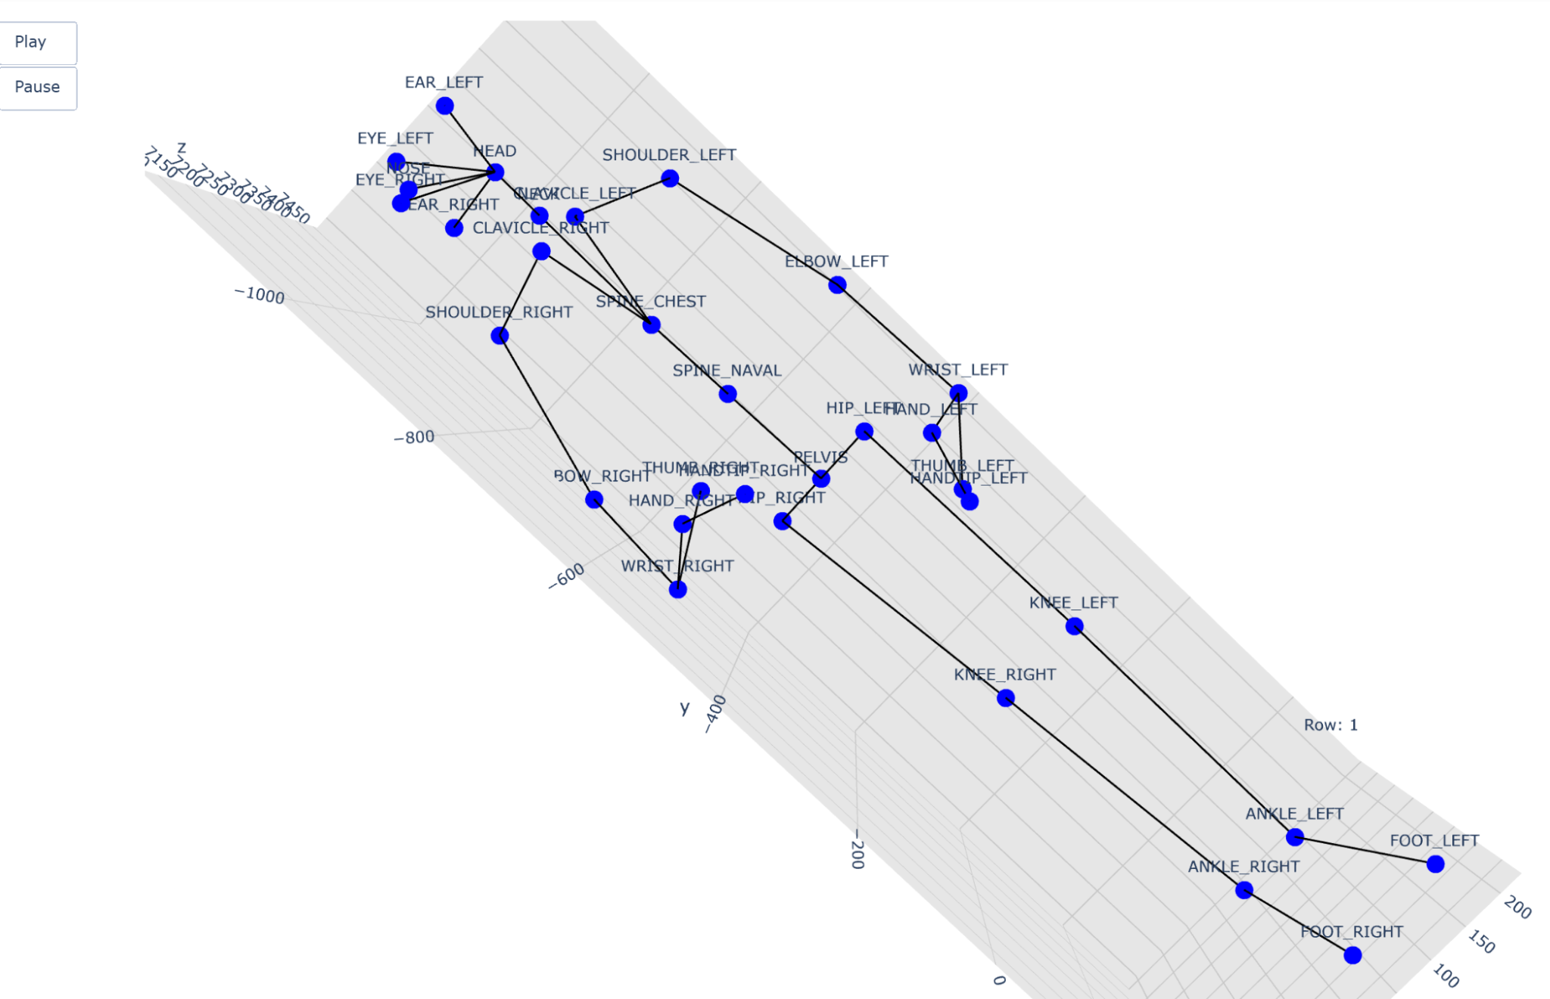
Concept Design For Graph Neural Net Method
32 joints
Each Has 3d coordinates [x, y, z]
3d GNN Porblem
Concept Plot
Actual Plot

Slide 13
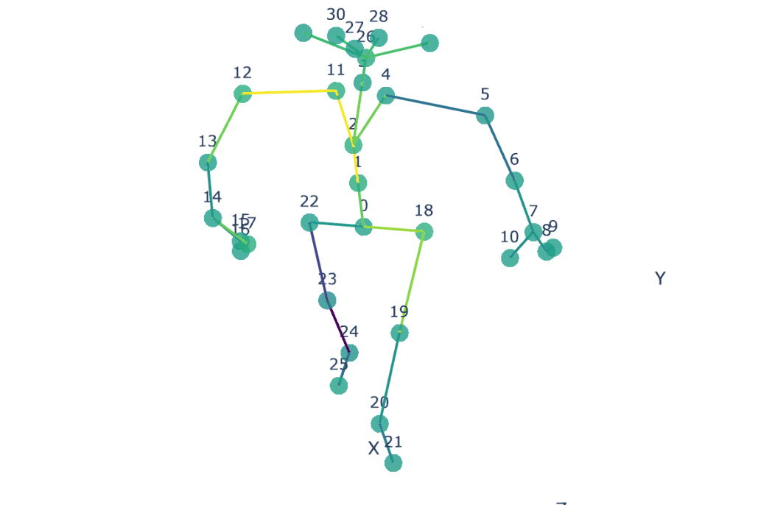
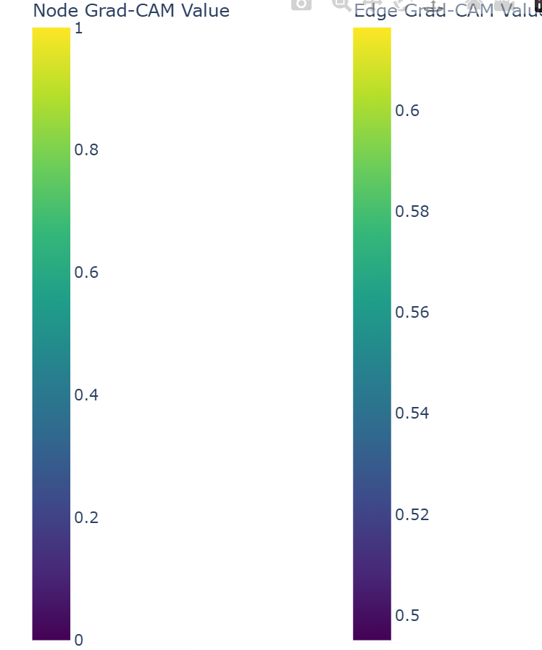
Concept Design For Graph Neural Net Method
Importance on Frailty Score
Grad Cam Node<->Edge Importance
Grad Cam Scale

Slide 14
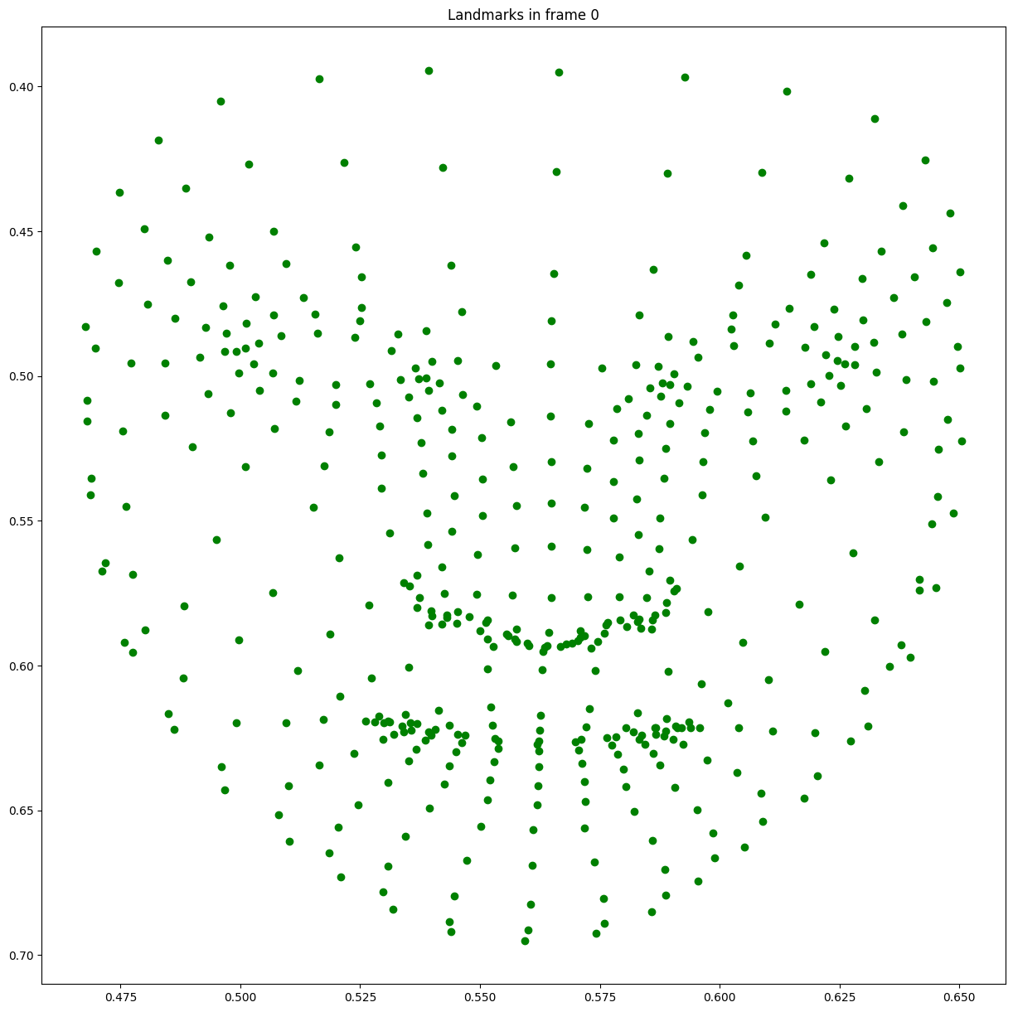
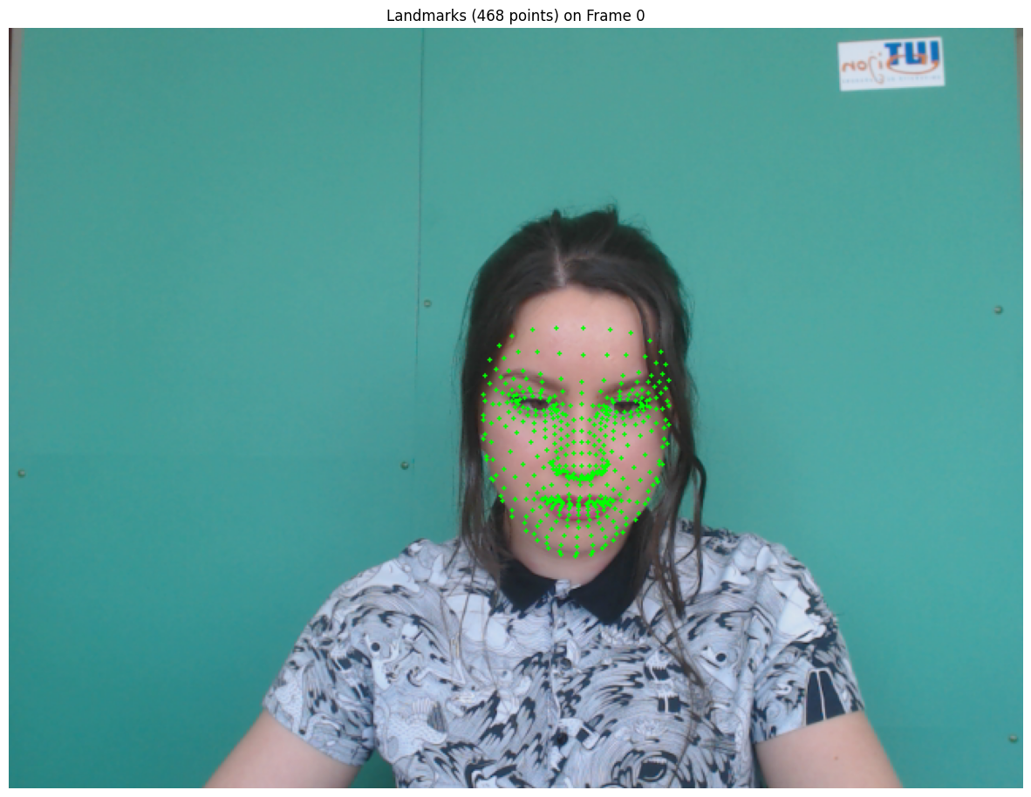
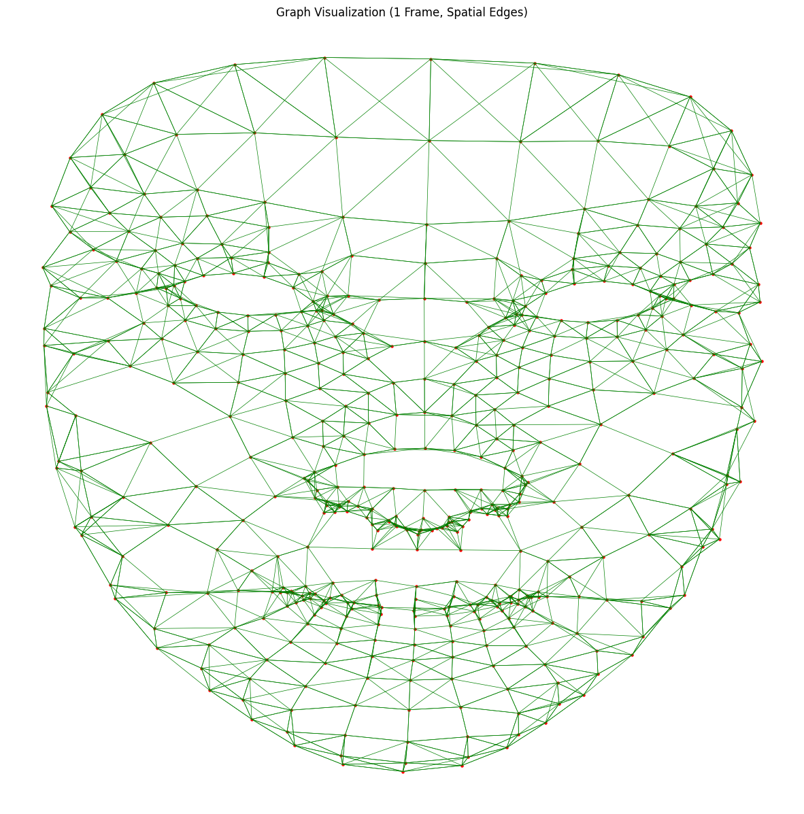
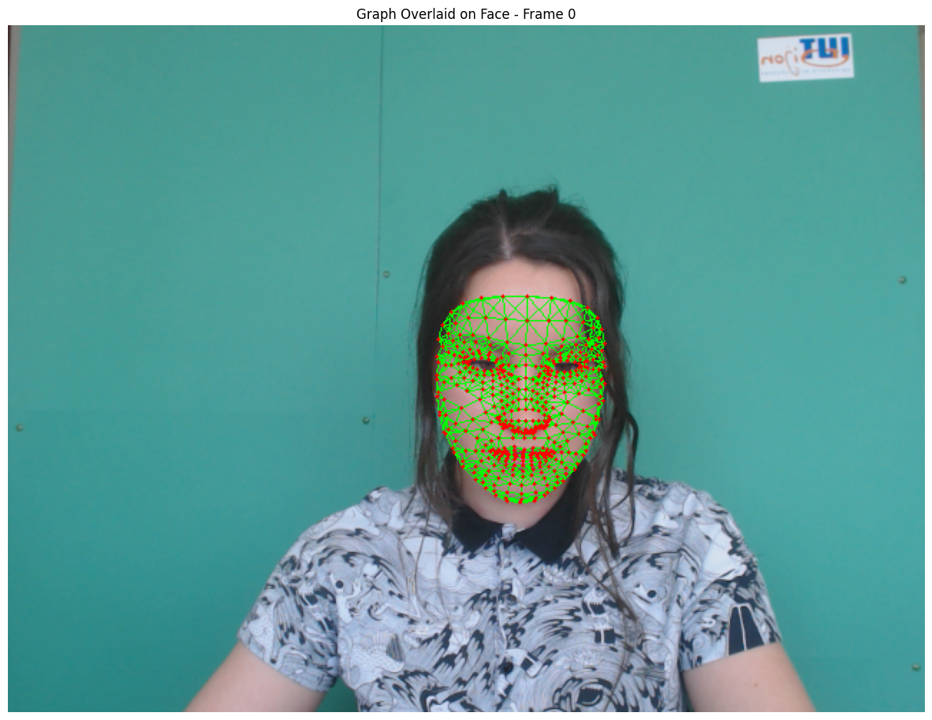
Concept Design For Graph Neural Net Method
Spatio-Temporal Graph Neural Network (ST-GNN)
468 facial landmarks (per frame) → nodes
Edges: k-NN structure (e.g., each landmark connects to its 6 closest neighbors) [LINK]
Time: Link same node across frames = temporal edge
Nodes = facial points, each with a vector of features
Edges = how these landmarks interact (spatial and temporal)
Landmark-aware GNN (Variant of ST-GNN)
Node feature = [x, y] + CNN feature of patch [Link]
➤ CNN captures skin texture, color, light changes —
Which change subtly due to blood flow / breathing = key for rPPG

Slide 15
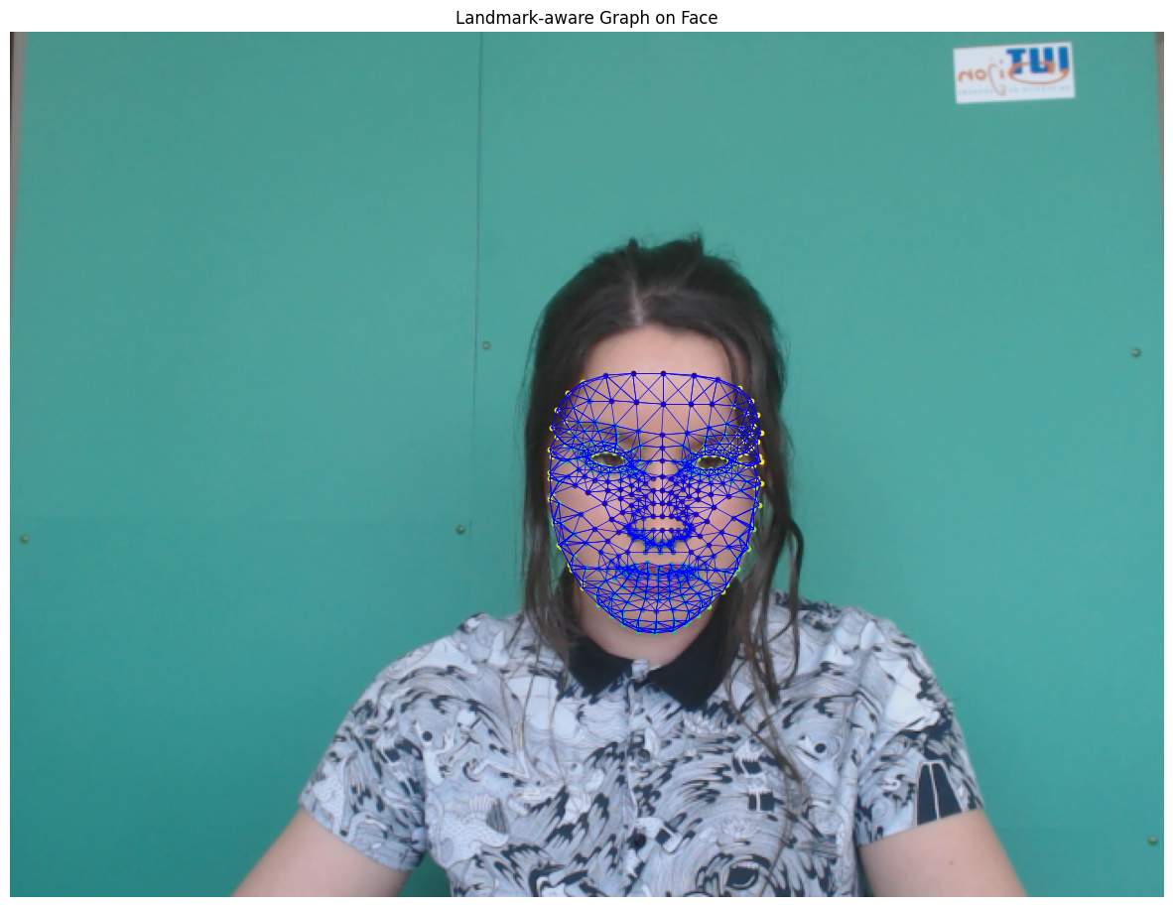
Concept Design For Graph Neural Net Method
CNN feature of patch

Slide 16
Conceptual Model Architecture
Basic flow:
Input: [window_size × 468, 2] node features
GraphConv layers:
Node updates via neighbors (local motion aggregation)
Global Pool:
Merge all node signals to 1 representation
Linear head → RR prediction
What ST-GNN learns:
How landmark motion correlates with breathing
Which regions move together (e.g., cheeks, nose)
Temporal shifts of these motions

Slide 17
Conceptual Model Architecture Implementation
Spatio-Temporal Graph Neural Network (ST-GNN)
Landmark-aware GNN (Variant of ST-GNN)
class STGNN_RR(nn.Module):
def __init__(self, in_channels=2, hidden_channels=64):
super(STGNN_RR, self).__init__()
self.conv1 = GCNConv(in_channels, hidden_channels)
self.conv2 = GCNConv(hidden_channels, hidden_channels)
self.conv3 = GCNConv(hidden_channels, hidden_channels)
self.regressor = nn.Sequential(
nn.Linear(hidden_channels, 64),
nn.ReLU(),
nn.Linear(64, 1) # Output: RR
)
def forward(self, x, edge_index, batch):
x = F.relu(self.conv1(x, edge_index))
x = F.relu(self.conv2(x, edge_index))
x = F.relu(self.conv3(x, edge_index))
# Pool across graph (mean of all nodes in each graph)
x = global_mean_pool(x, batch)
return self.regressor(x).squeeze(1)
class LandmarkAwareSTGNN(nn.Module):
def __init__(self, in_channels=34, hidden_channels=64):
super().__init__()
self.conv1 = GCNConv(in_channels, hidden_channels)
self.conv2 = GCNConv(hidden_channels, hidden_channels)
self.conv3 = GCNConv(hidden_channels, hidden_channels)
self.regressor = nn.Sequential(
nn.Linear(hidden_channels, 64),
nn.ReLU(),
nn.Linear(64, 1)
)
def forward(self, x, edge_index, batch):
x = F.relu(self.conv1(x, edge_index))
x = F.relu(self.conv2(x, edge_index))
x = F.relu(self.conv3(x, edge_index))
x = global_mean_pool(x, batch)
return self.regressor(x).squeeze(1)

Slide 18
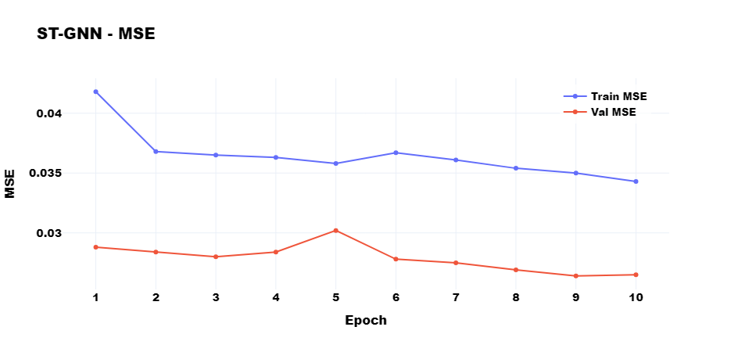
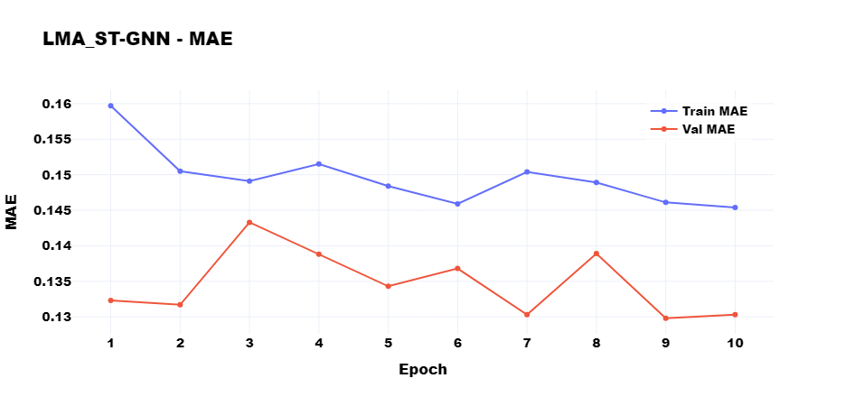
Conceptual Model Architecture Results
Total Subject: 5 , Epoch: 10
Spatio-Temporal Graph Neural Network (ST-GNN)
Landmark-aware GNN (Variant of ST-GNN)
MAE: 0.1307
RMSE: 0.1627
Pearson’s r: 0.2923
MAE: 0.1303
RMSE: 0.1633
Pearson’s r: 0.2757

Slide 19
Thanks
Any questions?

